Slide 1

VOLTORB
SEPTEMBER
2021

Slide 2
Problem Statement
Mrs. Zelner is a music lover. Not a day in her life goes without music. Keyboard is her favorite instrument and she excels in playing it. Her grandson has come to visit her during vacations and the country has just announced lockdown due to Covid -19. Here is a situation where Mrs. Zelner has dropped the keyboard from upstairs, and the keyboard is now completely shattered. Her grandson is bored and he wants to listen to her play. Being her neighbour, why don't you give her a helping hand in this situation?
Instructions:
1. Help Mrs. Zelner by building a mini keyboard that satisfies her grandson.
2. Usage of Microcontroller is allowed.
3. Creativity and additional features attracts more points.

Slide 3
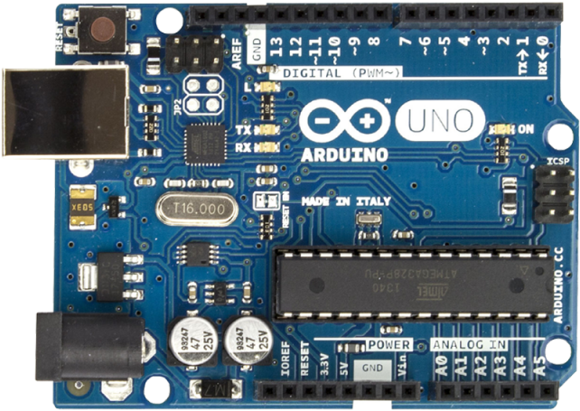
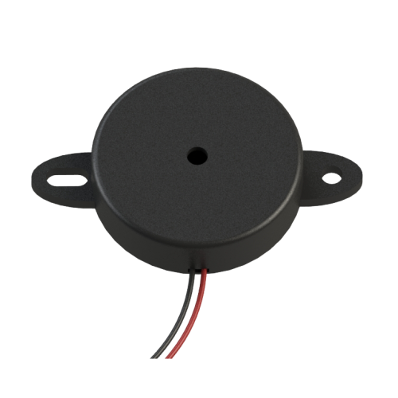
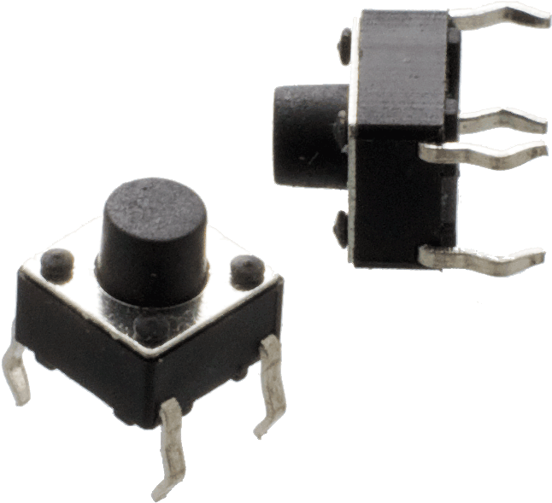
MEET THE GANG
Push Buttons
Acts as key for each musical note
Microcontroller
We’ll program this to behave like an electronic keyboard
Piezo Buzzer
This is our mini speaker that outputs tones

Slide 4
ARDUINO
tone(pin, frequency);
tone(pin, frequency, duration);
Generates a square wave of the specified frequency (and 50% duty cycle) on a pin. A duration can be specified, otherwise the wave continues until a call to noTone(). The pin can be connected to a piezo buzzer or other speaker to play tones.

Slide 5
FREQUENCY CHART
Sa Re Ga Ma Pa Da Ni
C D E F G A B
523 Hz 587 Hz 659 Hz 698 Hz 783 Hz 880 Hz 987 Hz

Slide 6
PROCEDURE
PUSH BUTTONS
ARDUINO
PIEZO BUZZER
Connect the Push Buttons to Arduino for each musical note.
Use the tone() function to generate a musical note upon pressing of the respective push button.
For Example:
To play the note ‘Sa’:
tone(buzzerpin, 523);
The Piezo Buzzer should be connected to any one of the PWM Pins on Arduino.
A Digital Pin is also a PWM pin if it has (~) symbol next to the
pin number.

Slide 7
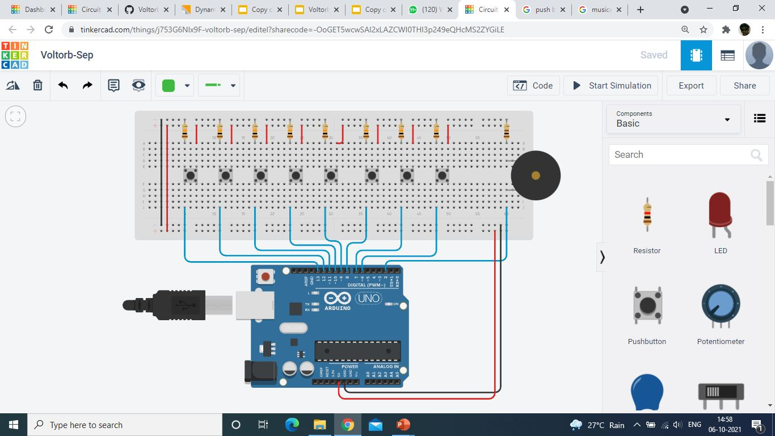
Simulation
To simulate this project, you may use some of the Easy to Learn -User Friendly & Free to Use applications like Tinkercad.

Slide 8
THANK YOU
IEEE UVCE PES
Working Simulation: https://drive.google.com/file/d/1eOXyqniHzJdNx15SzdP2tPXlABKhPDub/view?usp=sharing

